Slide 1
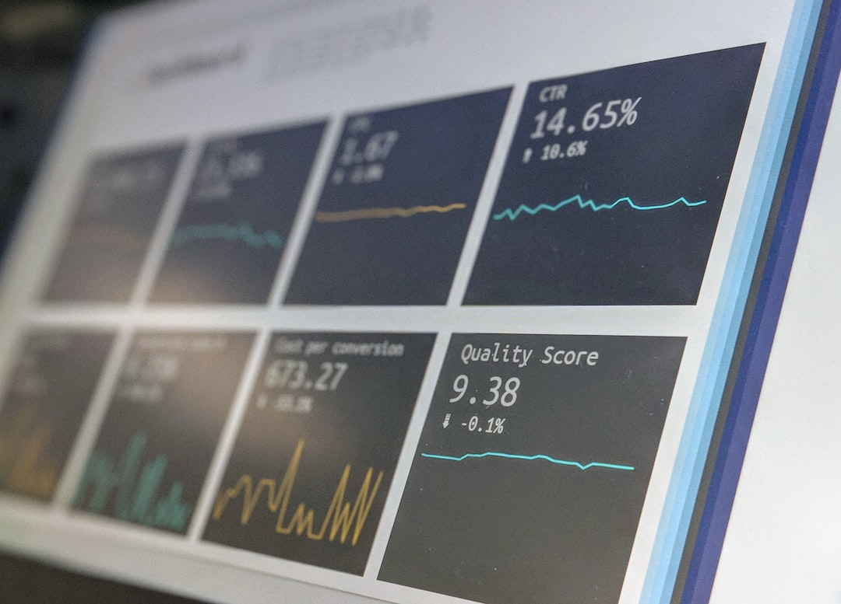

Sales Insight.

Slide 2

Atilq hardware is a company which supply computer hardware and peripherals to many clients across India.
The company head office is in Delhi and has a lot of regional offices across India
Problem
The sales director of the company is having issues with the insight of his business. As the market is growing dynamically, he is facing issues in terms of tracking his business sales.
He wants to get understandable insight of his company sales .

Slide 3
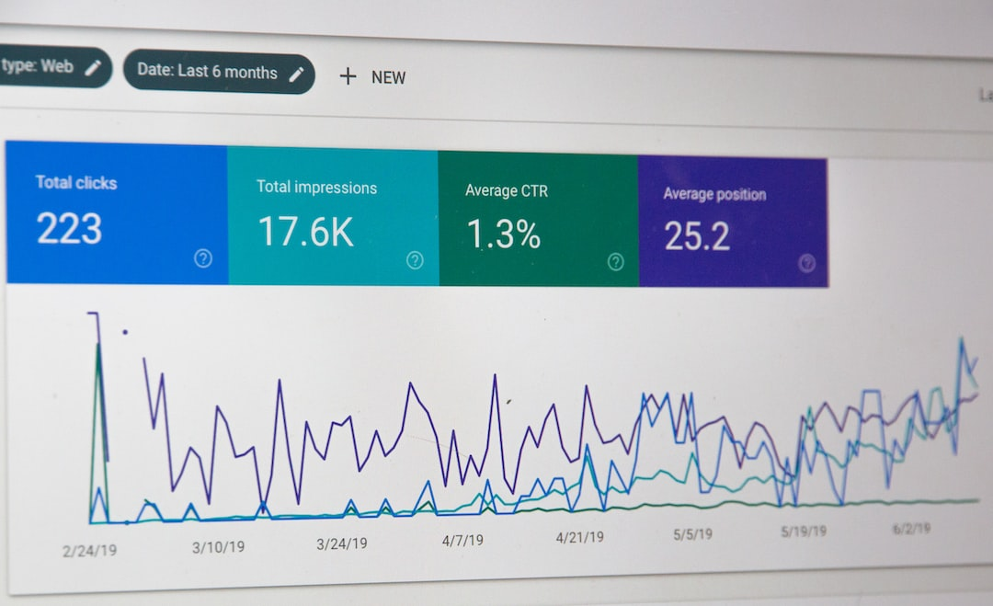
Solution
The sales director is interested in a visualized report where he can look the real sales data of the company and get a full insight of sales.
Atliq Hardware has a sales management system that keeps track of all the sales records stored in MySQL database. I used the data in MySQL database and connect it to PowerBI to build the dashboard.

Slide 4

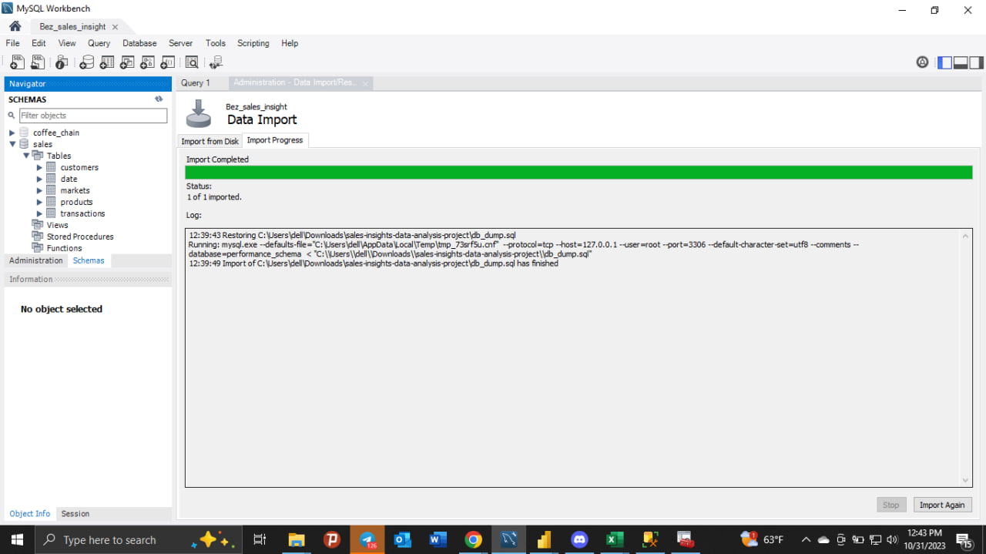
Data Collection : Import the data to MySQL database from file.

Slide 5
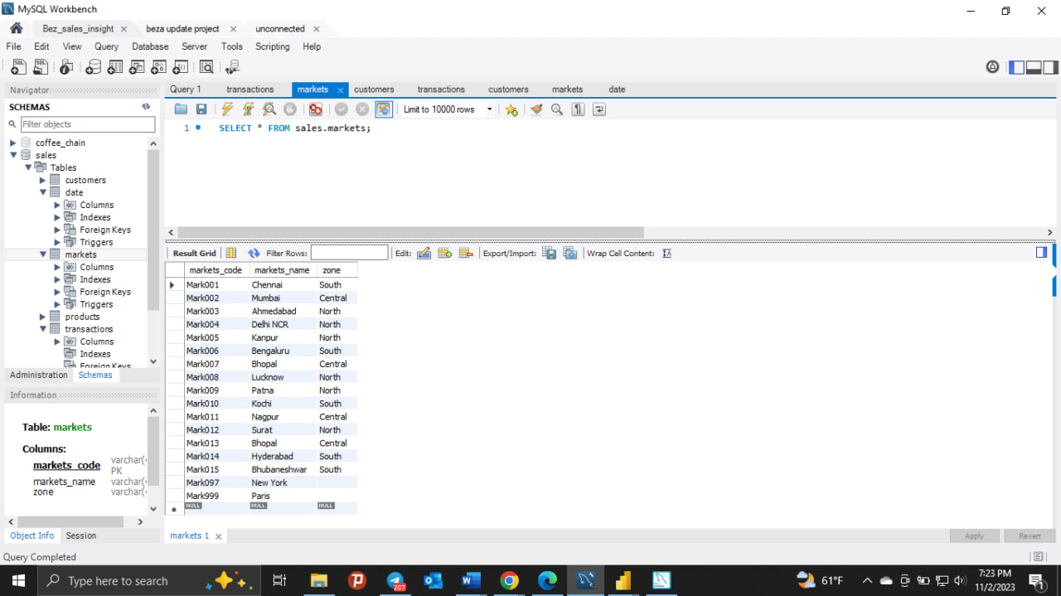
The database has all of the data that are included in the sale like Names(customers, Market, Product), Date, Year, Zones….

Slide 6
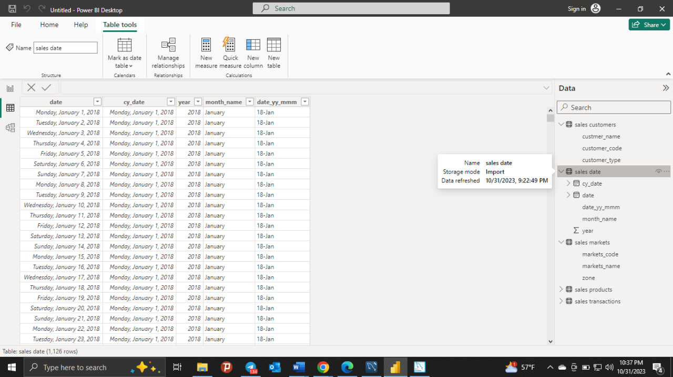
Then we connect the database with PowerBI so we can get all the sales data from the database.

Slide 7
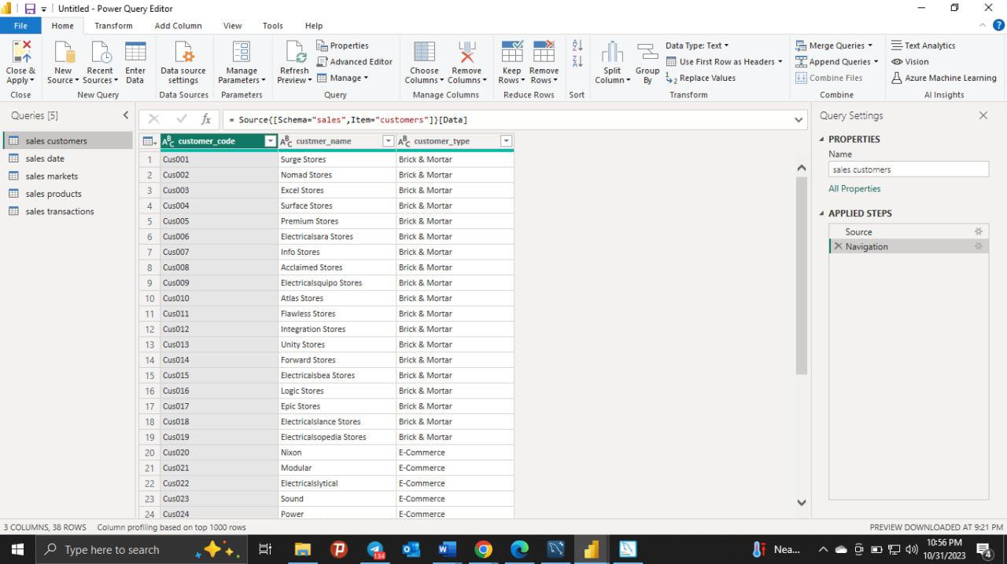
Data Cleaning : Now using Power Query Editor we clean the data from errors, duplications, and transform the data to useable format to build our dashboard.

Slide 8
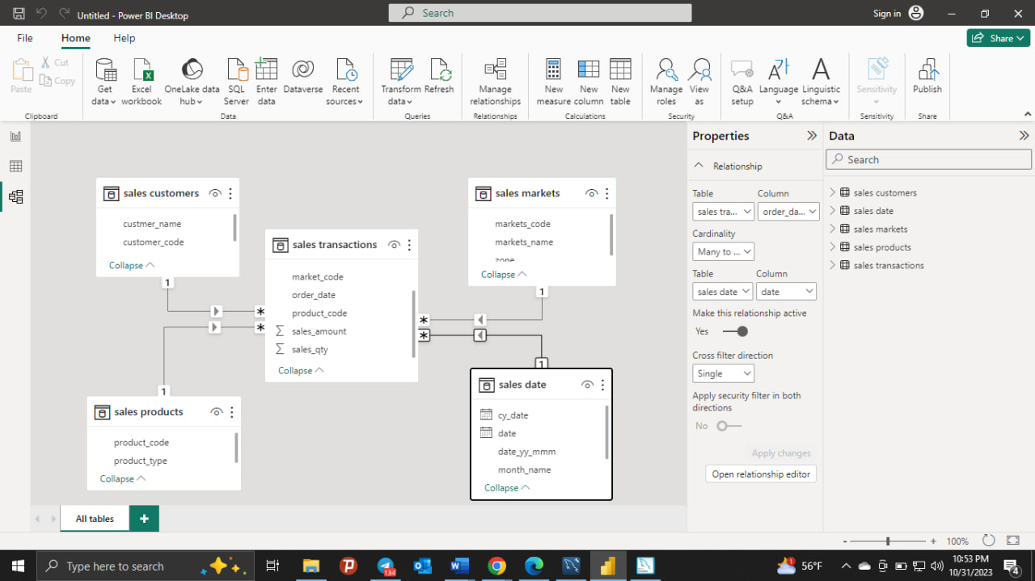
So we can do data modeling in the PowerBI . By default it establish some relationship but we can do it manually by drag and drop.

Slide 9
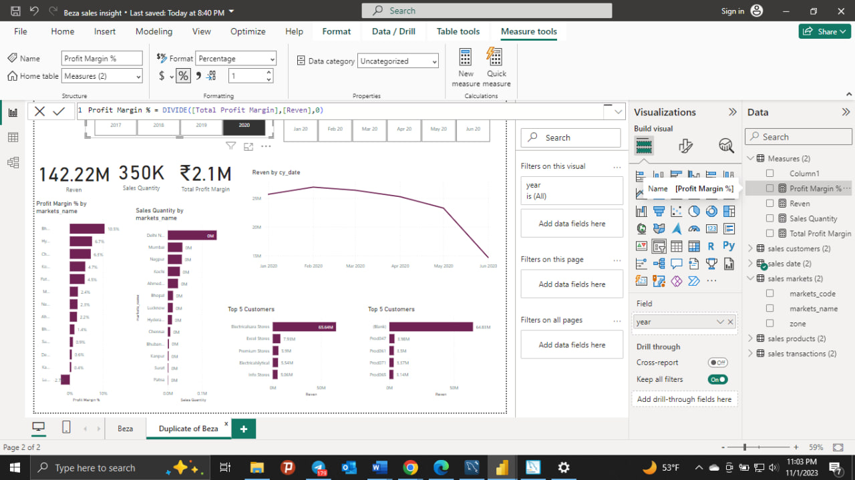
Analyze the data : After creating some parameters we want to see in order to get the sales insight of the company.

Slide 10

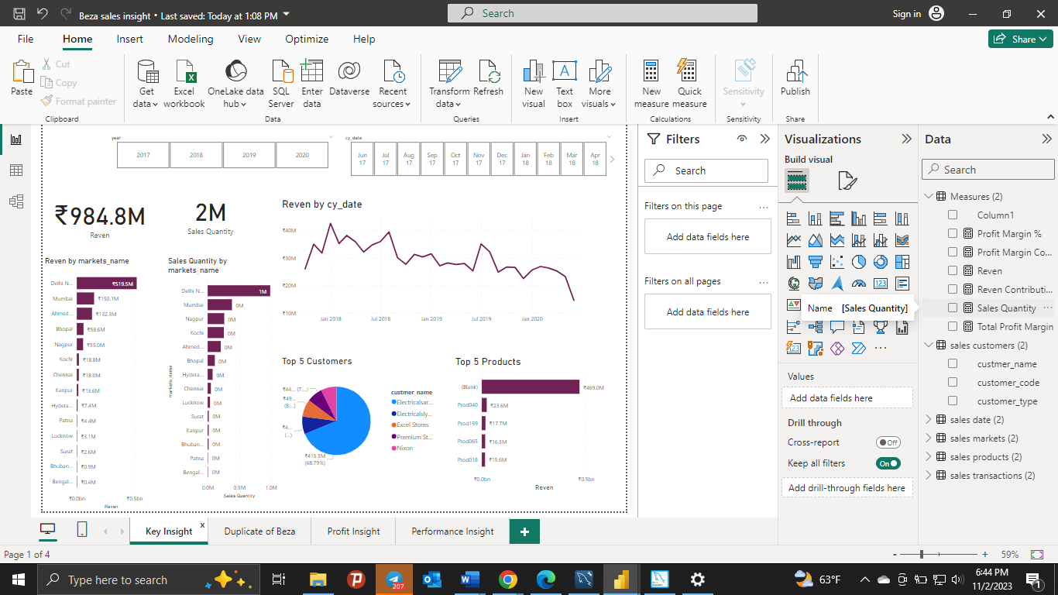
Data Visualization : Using the parameters we created we built our dashboard

Slide 11



